Slide 1

Presented by - Rahul M

Slide 2

INTRODUCTION PROBLEM STATEMENT DATA DESCRIPTION DATABASE SCHEMA INSIGHTS STRATEGY CONCLUSION
Agenda

Slide 3

Introduction
Welcome to the presentation of this analysis project, which aims to improve the bank's retention strategy by better understanding customer behaviour. This project focuses on analyzing various aspects of customer interactions, financial behaviors, and demographic trends to derive actionable insights. By exploring the customer churn patterns, spending habits, and response to marketing initiatives, I aimed to develop strategies that not only retain existing customers but also attract new ones.
The project utilizes a robust dataset encompassing customer information, transaction details, credit scores, and demographic profiles. Through advanced analytics and visualization techniques, I have uncovered valuable insights that will guide in making data-driven decisions to optimize customer satisfaction and business growth.
Let's dive into the details of our data journey and explore the insights that will drive into the strategic initiatives going forward.

Slide 4

Problem Statement
You are an analytical CRM (Customer Relationship Management) specialist hired by a bank to extract meaningful insights from various customer-related datasets. The bank aims to reduce customer churn, improve service delivery, and enhance customer satisfaction. They have provided you with datasets including customer demographics, transaction details, customer exit information, and active customer profiles.

Slide 5

Data Description
Row Number: The row number in the dataset, likely used for reference or indexing.
Customer Id: A unique identifier for each customer.
Credit Score: A numerical representation of the customer's creditworthiness.
Geography ID: A numerical identifier that likely corresponds to a geographical location, such as a country or region.
Gender ID: A numerical identifier for the customer's gender, where for example, '1' could represent male and '2' could represent female.
Age: The age of the customer.
Tenure: The number of years the customer has been with the bank.
Balance: Current balance in the customer's account.

Slide 6
Data Description
Num Of Products: refers to the number of products that a customer has purchased through the bank.
Has Cr Card: denotes whether or not a customer has a credit card. This column is also relevant, since people with a credit card are less likely to leave the bank.
Is Active Member: active customers are less likely to leave the bank (as per the criteria defined by the bank for identifying the activeness).
Estimated Salary: as with balance, people with lower salaries are more likely to leave the bank compared to those with higher salaries.
Exited: whether or not the customer left the bank.
Bank DOJ: date when the Customer associated/joined with the bank.

Slide 7
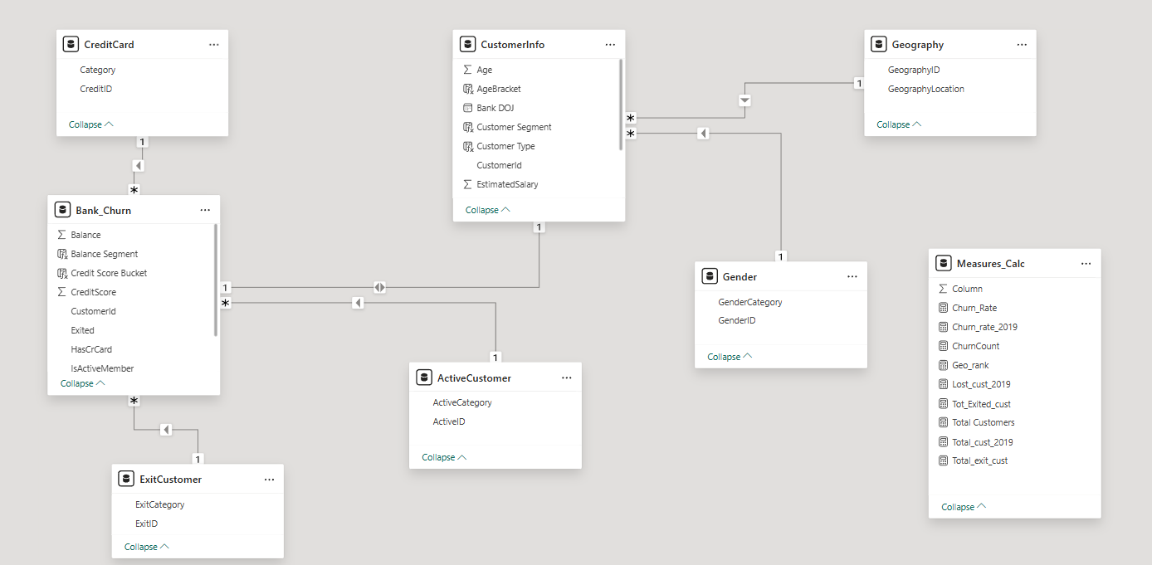
Database Schema

Slide 8



Analytical Approach & Tools
Data Cleaning and Formatting
Used Excel for initial data cleaning tasks, including removing duplicates, and formatting columns for consistency.
Conducted data profiling to understand the dataset's structure, identify patterns, and assess data quality.
Data Storage and Manipulation
Imported the Excel Data into SQL database
Analyze the customer churn by writing SQL Queries to correlate customer attributes with the churn rates.
Data Analysis and Visualization
Used the queries and original files to process data in Power BI
Develop interactive dashboards to display balance details, churn rates and customer details.

Slide 9

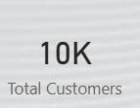

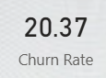
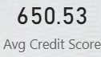
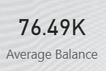
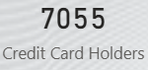
Overview
Total Customers
Churn Rate
Avg Credit Score
Avg Balance
Credit Card Holders

Slide 10
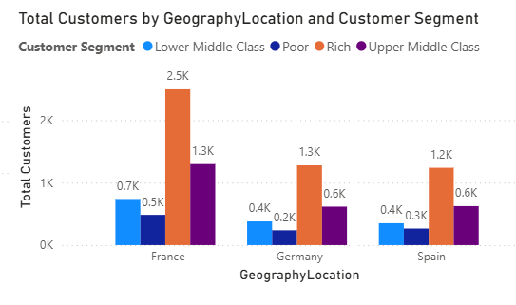
Customer Distribution by Segment and Country
Key Observations -
France dominates the Rich segment with 2.5K customers nearly double Germany and Spain.
Upper Middle Class is the second-largest segment across all three countries, especially in France (1.3K).
Lower income segments (Poor and Lower Middle Class) are consistently smaller, with Germany showing the lowest numbers (Poor: 0.2K, Lower Middle Class: 0.4K).
Strategic Insights -
Market prioritization: France is clearly a hotspot for affluent customers. Ideal for luxury or premium product targeting.
Segment focus: Upper Middle Class is a stable mid-tier across geographies great for scalable offerings.

Slide 11
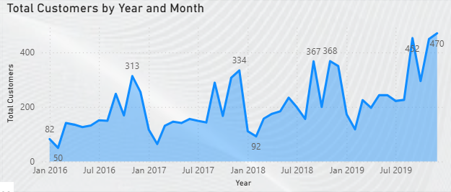
Customer Acquisition Overview
Key Observations –
Strong growth trend: From just 50 customers in Jan 2016 to 482 by Oct 2019, the overall trajectory is upward.
Seasonal spikes: January of each year shows noticeable peaks (313 in Jan 2017, 334 in Jan 2018, 367 in Jan 2019), suggesting possible annual campaigns or renewal cycles.
Mid-year dips: July 2018 shows a sharp drop to 92, which could indicate churn, seasonality, or data gaps.
Final surge: Oct 2019 hits the highest point at 482, followed by a slight dip to 470 in Dec 2019 still strong, but worth exploring retention or conversion factors.

Slide 12
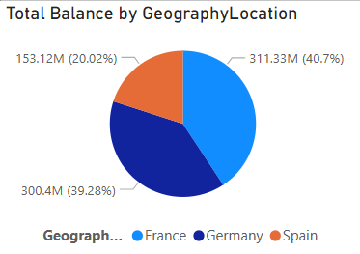
Total Balance of Customers in each Region
Key Observations –
Among the three regions in the dataset. France has highest account balance.
From this pie chart that we can visualize and see total distribution of balances across different regions.
Germany is 2nd most country having Balance and slightly lower than France.
Spain is lower among all the three country. It is almost half of Germany’s balance. Recorded balance in Spain is 0.15 billion.

Slide 13
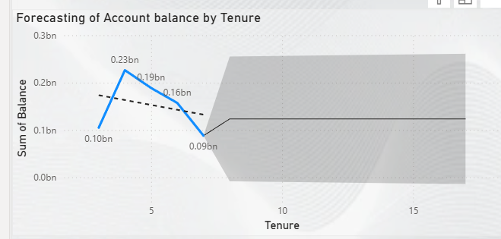
Forecasting of Account Balance
Key Observations –
It displays the relationship between the tenure of an account and the sum of the account balance, presumably forecasting future balances based on the length of the account's existence.
The graph suggests that the account balance is expected to increase in the first few years, suffer a decline around the 5-year mark, recover somewhat, and then stabilize or decrease slightly after around 10 years. The shaded area suggests that the most reliable forecast is within the first 10 years.

Slide 14
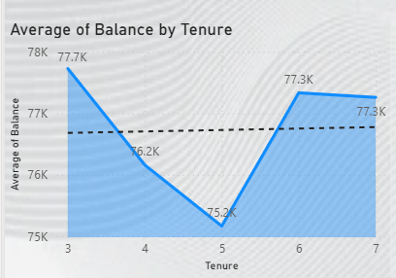
Average Balance by Tenure
Key Observations –
Tenure 3 leads with the highest average balance at 77.7K, slightly above the benchmark.
Tenure 5 dips to 75.2K, the lowest point in the range a clear deviation from the trend.
Tenure 6 and 7 stabilize at 77.3K, aligning with the benchmark line.
Strategic Insights -
Tenure 5 is a red flag: Customers at this stage may be experiencing disengagement, financial strain, or product misalignment. Consider targeted retention or upsell strategies here.
Tenure 3 is a sweet spot: High balances early on suggest strong onboarding or initial product fit. Reinforce early engagement tactics.
Use benchmark segmentation: The 77.3K line can help classify tenure groups into above/below-average cohorts for personalized financial strategies.

Slide 15
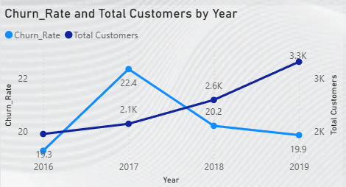
Churn Rate vs Total Customers
Key Observations –
No. of Customers are significantly increasingly year by year, whereas 2019 reaches 3.3k with a total of 10k customers.
Churn rate was highest in the year of 2017, 22.4 and lowest in the year of 2019, 19.9.
There is a negative relation between churn rate & customer growth
Strategic Insights -
Continuous focus is required on customer experience & retention programs.
As 2017 is showing highest churn so we have to analyse the reason to avoid future spikes. And 2019 is showing lowest churn along with highest customer acquisition, so we can follow the strategies taken to keep constant growth.

Slide 16
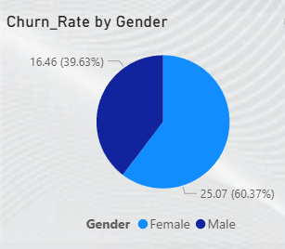
Gender wise Churn Rate
Key Observations –
Female customers account for a higher share of churn (60%) compared to male customers (40%).
This indicates that female customers are more likely to discontinue services than male customers.
Strategic Insights -
Retention should be more targeted towards female customers.
Design specific retention campaigns to reduce churn.

Slide 17
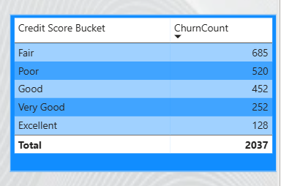
Churn Distribution by Credit Score Category
Key Observations –
Customers with Fair & Poor credit scores account for the highest churn, indicating higher risk segments.
Churn steadily decreases as credit score improves, showing inverse proportion.
Strategic Insights -
Higher Risk Segments need targeted retention strategies, personalized offers and flexible payment options .
Monitor Fair score customers closely, as they represent the largest churn opportunity.

Slide 18
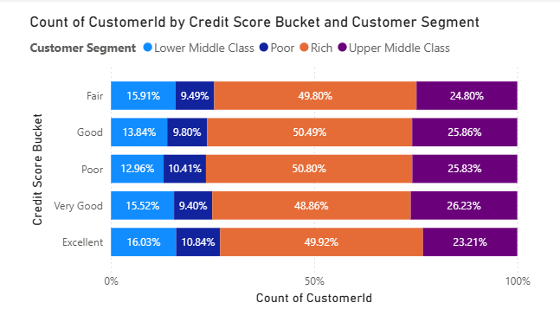
Churn Distribution by Credit Score Category
Key Observations –
Rich Segment Dominance – The Rich segment holds the largest share across all credit score buckets.
Lower Middle Class & Poor – These segments have the smallest shares.
Upper-Middle Class Stability – This segment remains fairly consistent.
Credit Score Distribution – Customer segments remain stable across credit scores, indicating no major shifts in composition.
Strategic Insights -
Target Fair & Poor credit score customers within Lower Middle & Poor segments - These groups show higher financial stress and should be prioritized for churn prevention and support programs.
Protecting high value Rich customers with declining credit scores – Even though they are financially strong, falling into Fair/poor buckets may signal early risks.

Slide 19
Key Insights
The poorest credit score segment (300-579) experiences the highest exit rate.
Possessing a credit card does not significantly affect churn rates.
The most common number of products among customers who have exited the bank is one.
Many customers join the bank during the months of August to December.
Individuals aged 30-50 hold the most credit cards.
The highest churn rate and the lowest number of active members indicate that Germany is a significant financial risk for the bank.

Slide 20
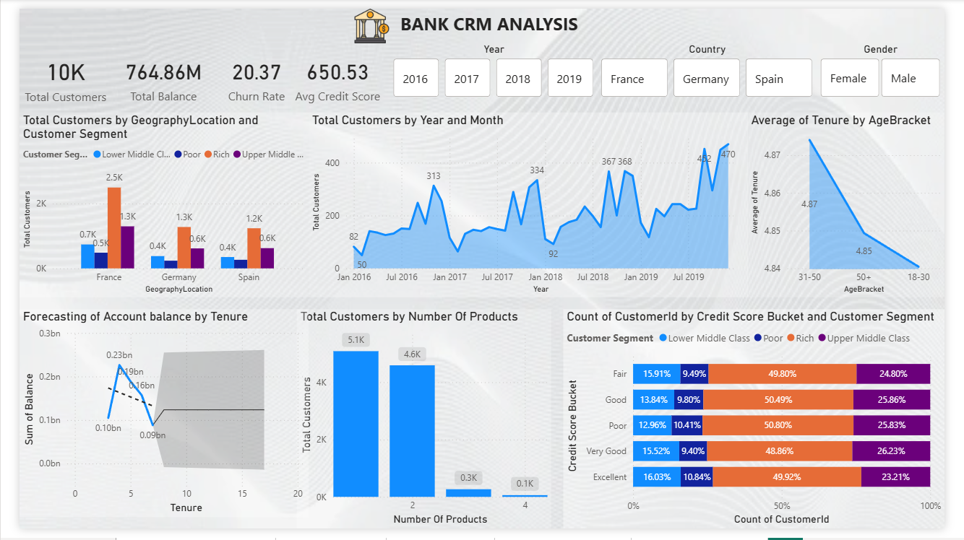
Dashboard & Visualization

Slide 21
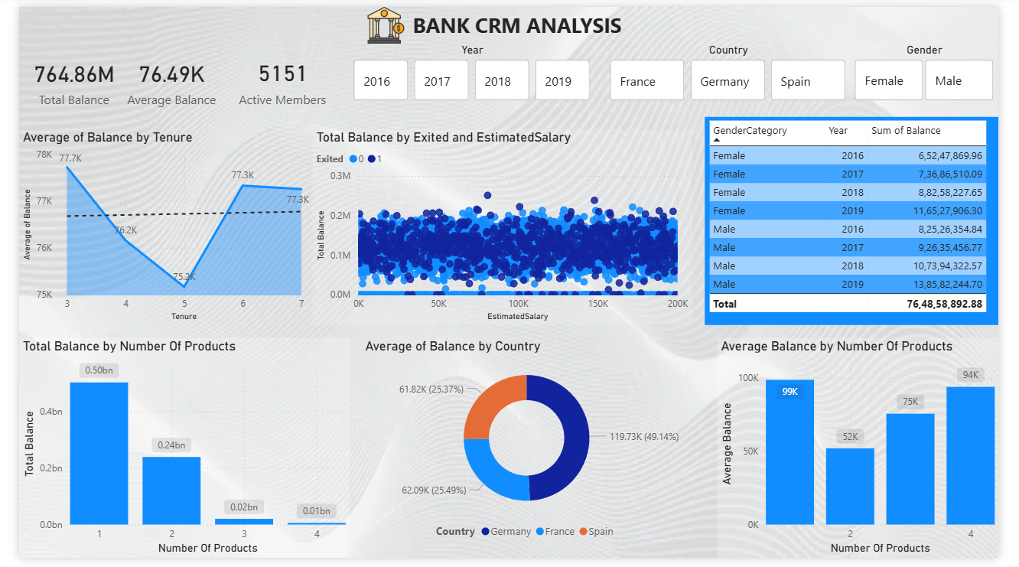
Dashboard & Visualization

Slide 22
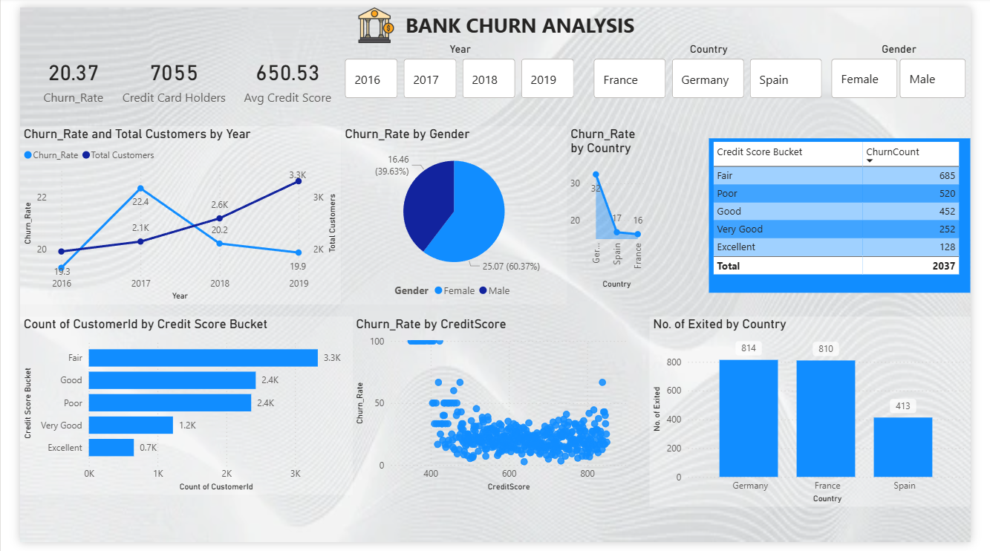
Dashboard & Visualization

Slide 23

Strategies
Churn Reduction Strategy -
Launch early intervention programs for customers whose credit score drops. Personalized retention offers for specific customers.
Credit Score Driven Customer Management –
Using credit score as a core risk indicator. We can take actions on the basis of the specific buckets.
Product Holding Optimization –
Customers with 3 -4 products show higher balances & stability. Bundle savings account + credit card + investment products. We can use dedicated relationship managers for high value customers to build up relationship.
Balance Growth Strategy –
Target mid tenure customers with balance boosting offers. Incentivize long term engagement using bonus interest, loyalty savings plan.
Location Specific Strategy –
Organize location level retention campaigns. Adjust pricing, service touchpoints and communication by region. Allocate more retention budget to high churn region.
Customer Segmentation Based Actions –
For high income segments upsell & wealth products, for lower income segments focus on affordability & trust. Avoid aggressive selling to financially stressed customers.
Referral Programs –
By incentivizing both referrer and referee we can acquire customers at lower cost. Activate referral campaigns in low churn segments.

Slide 24

Conclusion
The project delved into the intricacies of customer churn analysis within the banking sector. We gained valuable insights into customer behaviors, risk factors, and market trends. We identified key metrics such as churn rates, customer demographics, and product usage patterns, enabling us to formulate data-driven strategies for customer retention and acquisition.
However, it's crucial to note that customer churn is a complex phenomenon influenced by various factors beyond the scope of our dataset, such as customer experiences, market competition, and economic conditions. Therefore, while our analysis provides valuable insights, a holistic approach incorporating customer feedback, qualitative data analysis, and continuous monitoring is essential for sustained success in reducing churn and enhancing customer satisfaction.

Slide 25






Thank you

